Slide 1

The AITSL Standards through the
library lens
How do the standards affect library professionals?
12 June 2014

Slide 2
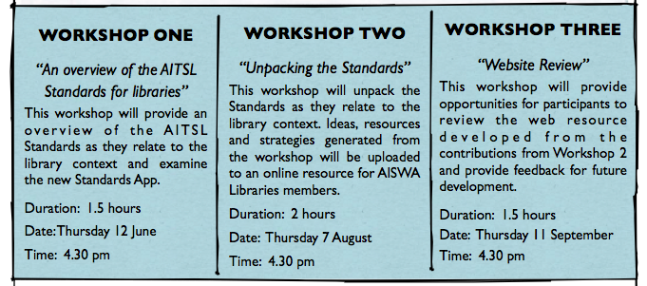
Workshop series

Slide 3
Workshop One
“An overview of the AITSL Standards for libraries”
This workshop will provide an overview of the AITSL Standards as they relate to the library context and examine the new Standards App.

Slide 4
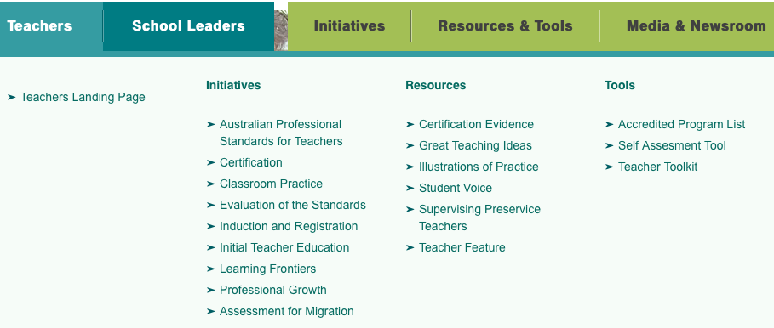

Slide 5
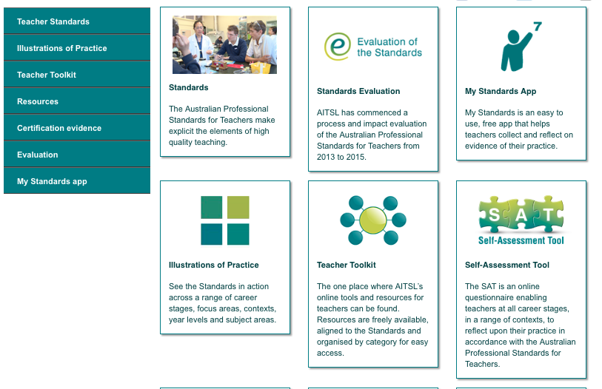

Slide 6

What are the standards?

Slide 7



Three Strands
Professional Knowledge
Professional Practice
Professional Engagement

Slide 8
Professional Knowledge
Know students and how they learn
Know the content and how to teach it

Slide 9
Professional Practice
Plan and implement effective teaching and learning
Create and maintain supportive and safe learning environments
Assess, provide feedback and report on student learning

Slide 10
Professional Engagement
Engage in professional learning
Engage professionally with colleagues, parents / carers and the community.

Slide 11
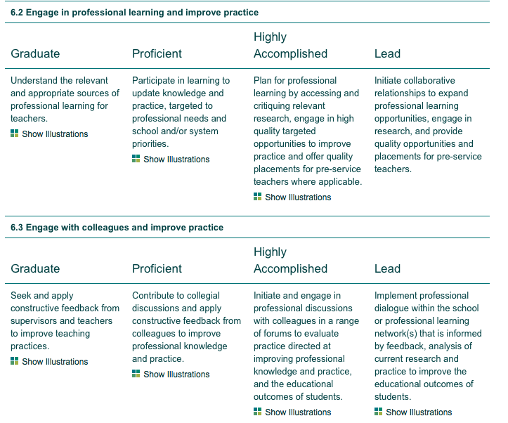

Slide 12
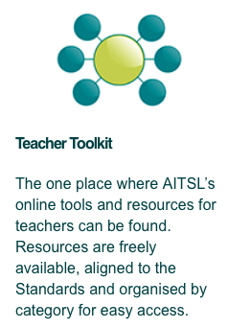

Slide 13
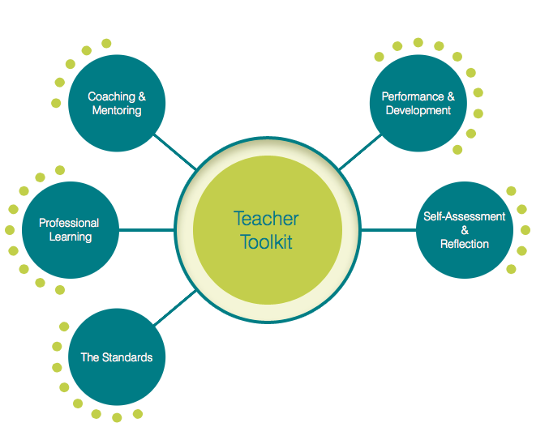

Slide 14
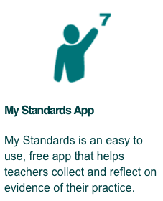

Slide 15
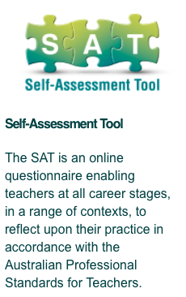

Slide 16


Slide 17
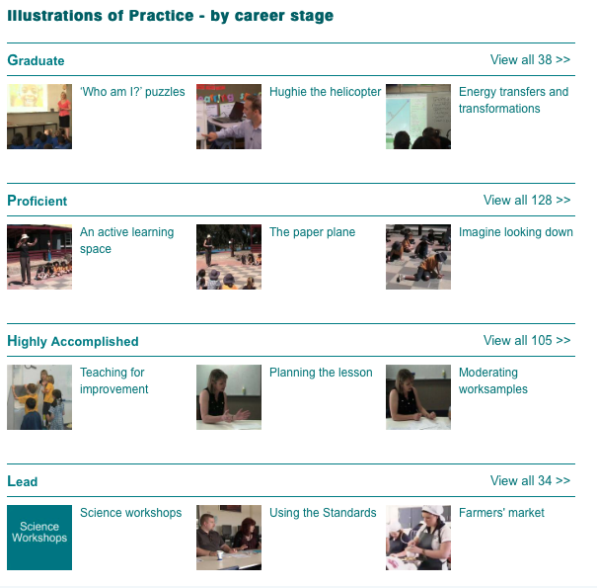

Slide 18


Slide 19
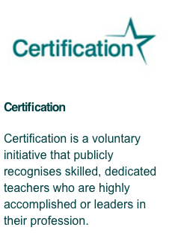

Slide 20

How do teacher librarians address these standards when often we do not teach in the classroom?

Slide 21

An example of how it is done
Alison Mackenzie

Slide 22

Evidence Guide

Slide 23

Learning for the Future

Slide 24

Other support resources

Slide 25

Website

Slide 26

Actions
You will be placed in a group that will examine one of the standards.
In your group allocate / nominate responsibilities for researching various aspects of the standard OR allocate sub- standards (eg 3.1, 3.2 etc)
Before the next meeting collect as much information as possible about your allocated area. (You may wish to post it on the website blog.

Slide 27
At session 2 you will share your information, findings, evidence, examples etc. and collate it into a manageable form to be placed on the website.
Before session 3 the collected evidence will be put on the website.
In session 3 you will examine and critique the information that has been placed on the website and provide feedback.

Slide 28

Group Activity

Slide 29
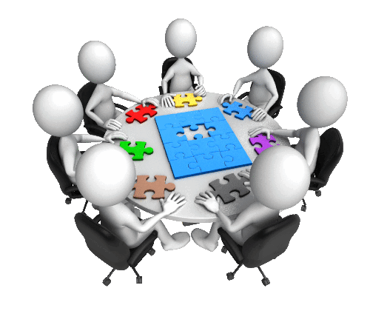
Recap

