Slide 1
AITSL Standards and Teacher Librarians

Slide 2
The Seven Standards ^{1. Know} ^{Students} ^{and} ^{How} ^{They} ^{Learn.} ^{2. Know the Content and How} ^{to Teach It.} ^{3. Plan} ^{for} ^{and} ^{Implement} ^{Effective} ^{Teaching} ^{and} ^{Learning.} ^{4. Create} and Maintain Supportive and Safe Learning Environments. ^{5. Assess, Provide} Feedback and Report on Student Learning. 6. Engage in Professional Learning. 7. Engage Professionally with Colleagues, Parents ^{/ Carers} ^{and the Community.}

Slide 3
Useful Documents
ASLA (Australian School Library Association) –
Evidence Guide for Teacher Librarians in the Highly
Accomplished Career Stage.
Available from ASLA members site – membership fee
more than covers the value of this document.
AISWA (Association of Independent Schools WA) –
Companion document to the Guide to Certification of
Highly Accomplished and Lead Teachers in Australia

Slide 4
Getting Started
* Get hold of the documents shown in the previous slide. * Tackle one standard at a time. * Work through each sub-section one at a time.
* Find a friendly colleague who is willing to do some observed lessons for you.

Slide 5
Breaking it Down
Each standard is broken down into a number of sub-sections, each of which should be addressed with evidence you have gathered.
Evidence can be used to address more than one sub-section.
Evidence can be taken from a number of different sources and can include things such as:
Certificates (e.g PD) Meeting Notes Student Activities
Emails Observed Lesson Notes Unit Programs
Lesson Plans Photographs PD you run
Work Samples Video Clips Reading Logs

Slide 6
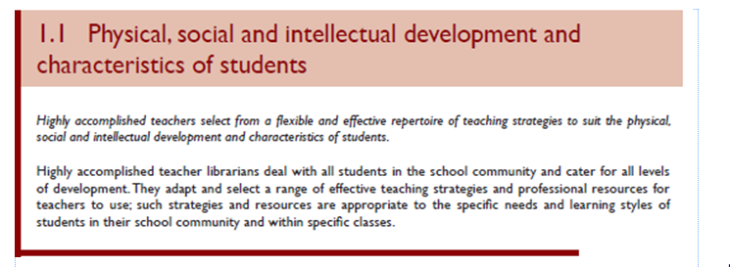
Organising the Evidence
(This is taken directly from the ASLA guide)

Slide 7
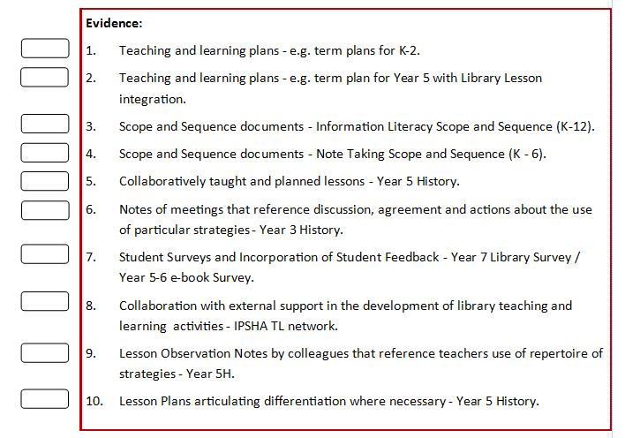
These evidence pointers are a mixture of examples from the ASLA guide which are specifically related to Teacher Librarians and the AISWA Companion Document which are more general in nature.

Slide 8
Section by Section!
As I read through each sub section and the accompanying evidence guide I made notes as to things which I could include as evidence.
Once this list was made, I collected the evidence and put it together in a folder ticking off each item on the list as I entered it into the folder.
I also made a point of saving an electronic version (where possible) into a folder specifically to dedicated to AITSL evidence. This electronic evidence can then be used in the future.

Slide 9
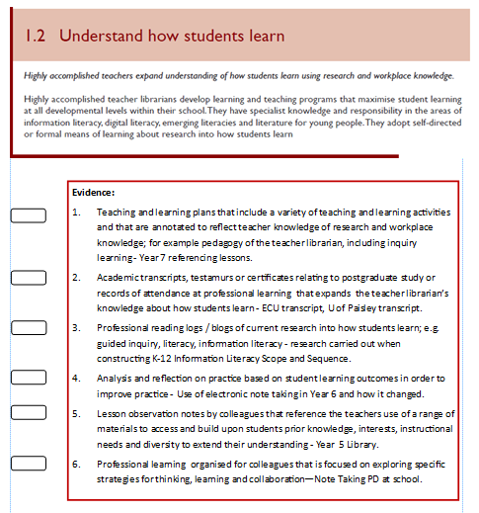
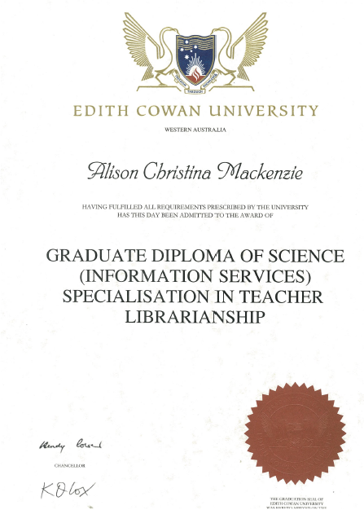
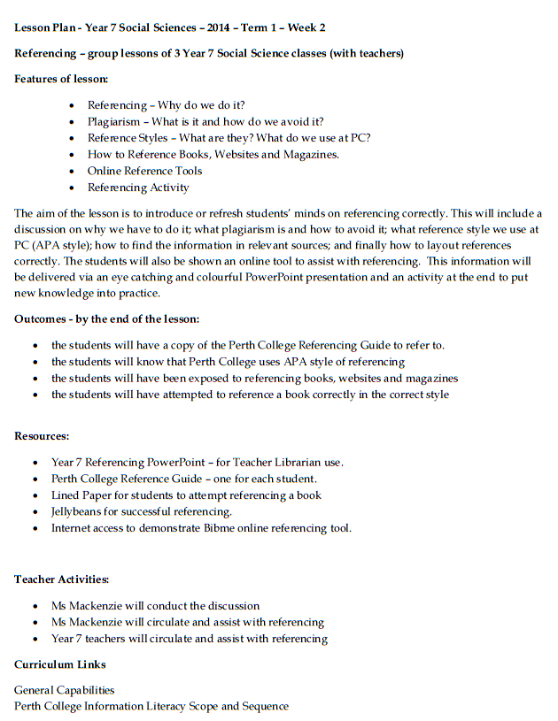
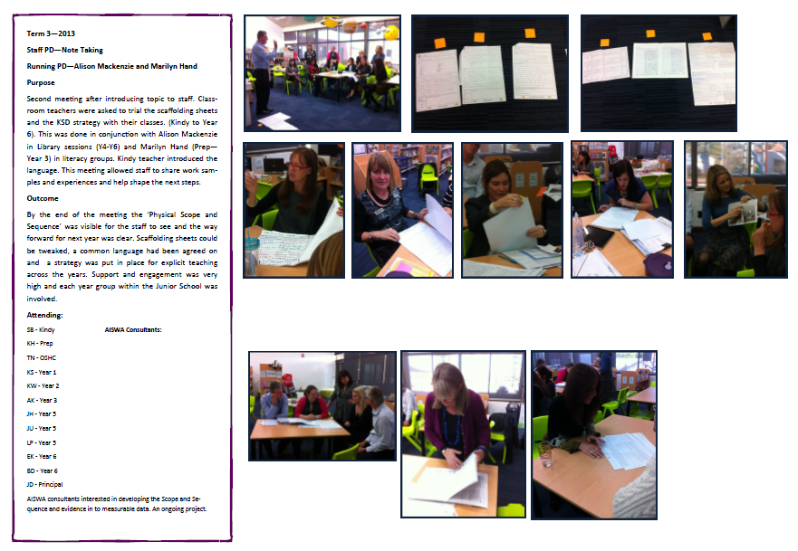
Collecting the Evidence

Slide 10
Top Tips
Don’t delete any emails from colleagues asking you to help with something related to the students, to the curriculum or any learning activities – these can be used as evidence.
If you have a conversation with a colleague relating to the students, to the curriculum or any learning activities – either make notes straight away or ask them to email you - these can be used as evidence.
Take photographs of everything you do e.g. displays, student work, learning activities etc. – these can be used as evidence.
Keep all certificates and notes etc. from Professional Learning Activities –
these can be used as evidence.
Collect anything you think may be used as evidence, keep it in a folder and you will probably find a sub-section that it will correspond to.

Slide 11
Time!
This has proven to be VERY time consuming affair but surprisingly satisfying!
As I am going along with this process, I have begun to feel more and more confident about what I actually do on a daily basis meets the standards for a Highly Accomplished teacher. I have become very aware of collecting evidence as I go along.
Collecting the evidence as you go along is much easier than trying to do it retrospectively.

Slide 12
Paper Copies
I started off with one lever arch folder divided into seven sections – I very quickly dispensed with this and have split each standard up into its own folder!
Electronic Options
Ejournal – an electronic evidence repository specifically designed around the organisation of the 7 standards. We have been provided with this at school, available on a personal basis.
My Standards App – for iPad – an interactive tool to store, organise and
annotate evidence. Produced by AITSL and free of charge to download
and register.

Slide 13
Examples
Please feel free to have a look through the folders I have brought along.
This is purely a personal system that I have found useful.

